Slide 1
Day 30
Simultaneous Localization and Mapping

Slide 2
SLAM
simultaneous localization and mapping
  one of the most fundamental problems in mobile robotics
a robot is exploring an unknown static environment
  robot is given sensor measurements and control inputs
    does not have a map
    does not know its pose

Slide 3
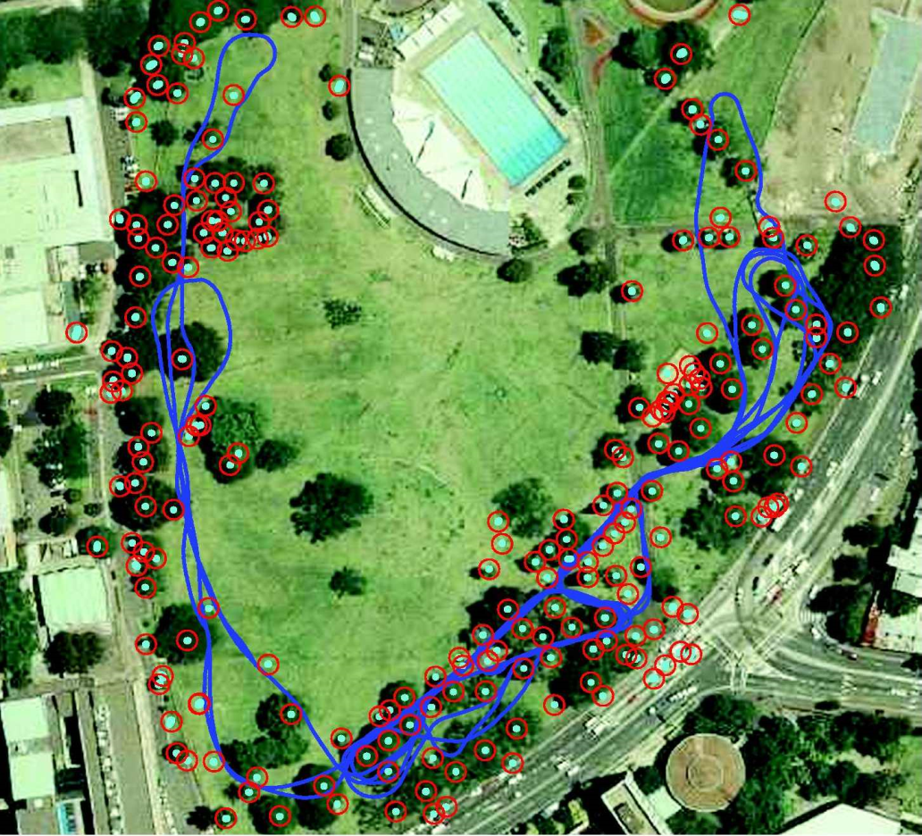
SLAM
robot must acquire a map while simultaneously localizing itself relative to the map
  harder than just localizing
    has no map
  harder than just mapping
    does not know its pose

Slide 4
Online SLAM
in the online SLAM problem, we wish to estimate
  the current pose of the robot x_{t} and
  the map variables m
we are given
  the sensor measurements z_{1:t} = {z₁, z₂, …, z_{t}} and
  the control inputs u_{1:t} = {u₁, u₂, …, u_{t}}

Slide 5
Online SLAM
the online SLAM problem is often expressed in a probabilistic framework
  compute the posterior probability
  what is the probability density function of the robot's current pose and the map given the history of sensor measurements and control inputs?

Slide 6
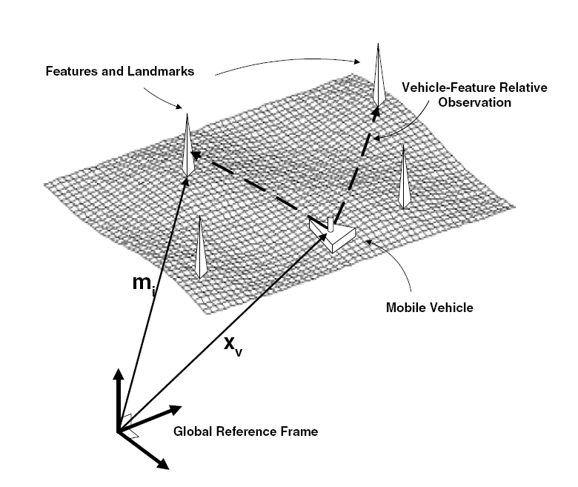
Landmark-Based SLAM

Slide 7
A Simple Landmark-Based SLAM Problem
given
  a directionless robot (i.e., don't care about orientation) that moves in controlled but noisy steps
  n fixed landmarks
  the robot can measure all of the landmarks all of the time in a controlled order
  the robot measures the relative offset from its position to each landmark

Slide 8
Kalman Filter: Plant or Process Model
describes how the system state changes as a function of time, control input, and noise
  state at time k
  control inputs at time k
  process noise at time k
  state transition model or matrix
  control-input model or matrix

Slide 9
Kalman Filter: Measurement Model
describes how sensor measurements vary as a function of the system state
  sensor measurement at time k
  sensor noise at time k
  observation model or matrix

